Slide 1

A wide Field of View atmospheric Cherenkov telescope based on a refractive water-lens for future gamma-ray astronomy
Tianlu Chen, Qi Gao, … (Tibet University)
Yi Zhang, Cheng Liu, Hui Cai, Zhen Wang, Hongbo Hu, … (IHEP)
BEIJING, CHINA, 2017/08/19

Slide 2
Outline
Introduction
Concept of Water-Lens Telescope
First Observation of CRs with the Prototype
Statues and Future Plans
Discussion and Conclusion
High altitude candidate site in Tibet

Slide 3
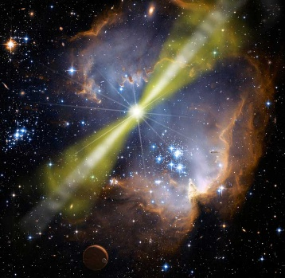
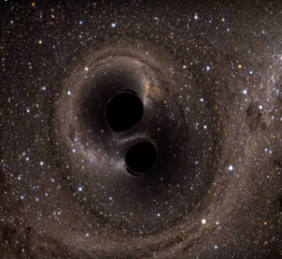
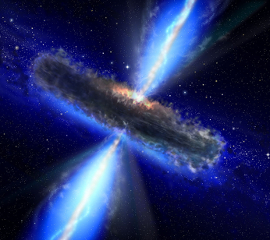
Motivation
A wide field of view and large dimensional Atmospheric Cherenkov Telescope array at high altitude site for observation of sporadic γ-ray sources, i.e, VHE emission of GRBs, possible VHE electromagnetic counterparts of
Gravitational Waves, VHE emission of AGNs.

Slide 4
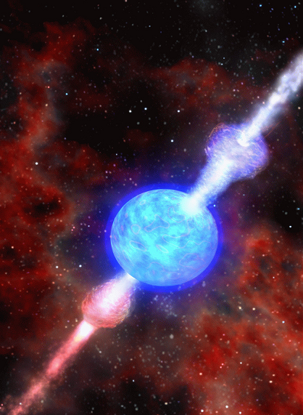
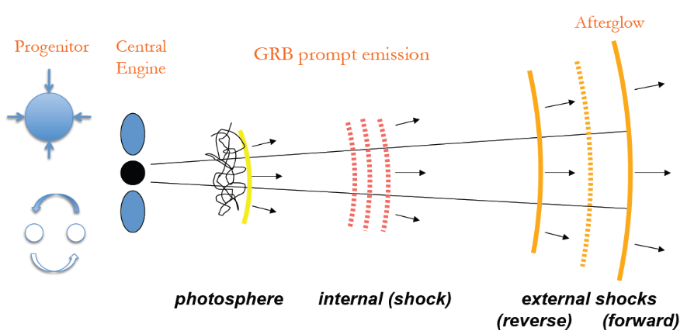
Why Study GRBs at Very High Energy (GeV-subTeV) ?
Gamma-ray bursts: the most violent explosions in the universe
Acceleration mechanisms , energetics, and therefore constrain the progenitors and jet feeding mechanism
Understanding progenitor then leads to an understanding of cosmology & stellar evolution required to support progenitor population
Extragalactic background light induced absorption (EBL absorption) of high energy photons
Limits on Lorentz Invariance Violation
Potential ultra high energy cosmic ray sources

Slide 5
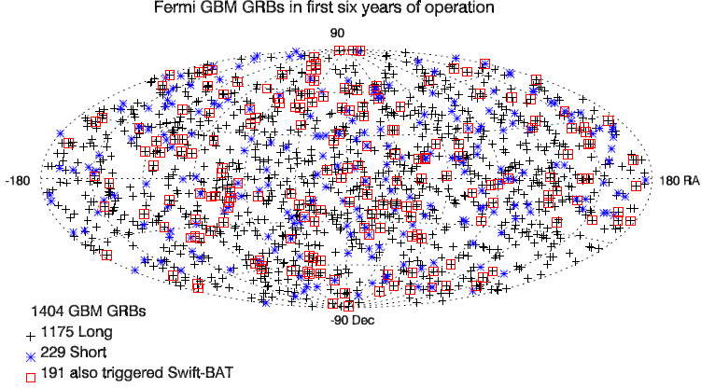
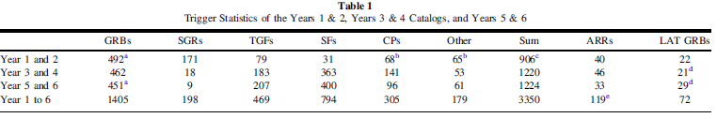
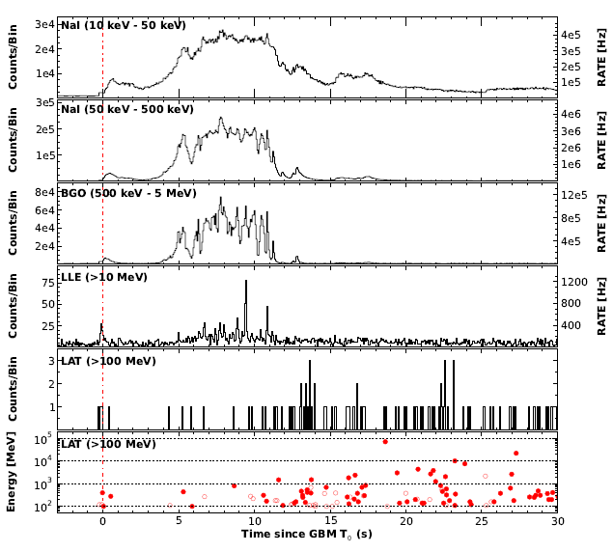
VHE emission of GRBs in Fermi era
APJS, 2016, 223:28 (18pp), 2016
LAT: 30 MeV–300GeV
GRB 130427A
GRBs have energies up to at least 100GeV.
GRB Name | Photon E_{max} | Redshift
GRB080916C | 13GeV | 4.35
GRB090510 | 31GeV | 0.903
GRB090902B | 33GeV | 1.822
GRB090926A | 19.6GeV | 2.1
GRB130427A | 95GeV | 0.145
GRB 940217 | 18GeV | /
Science, 2014, 343(6166), p.42(6) ; p.38(4) ; p.51(4);p.48（4）
Notes:
In gamma ray astronomy, Gamma ray bursts is long-lasting excited area. The are flashes of gamma rays associated with extremely energetic explosions that have been observed in distant galaxies.
A few of GRBs have very high energy photons, up to tens of GeV, even near to100GeV.Here list some fomous GRBs with very high energy photos.
Observation of GRBs with energy at sub-100GeV is meaningful.

Slide 6
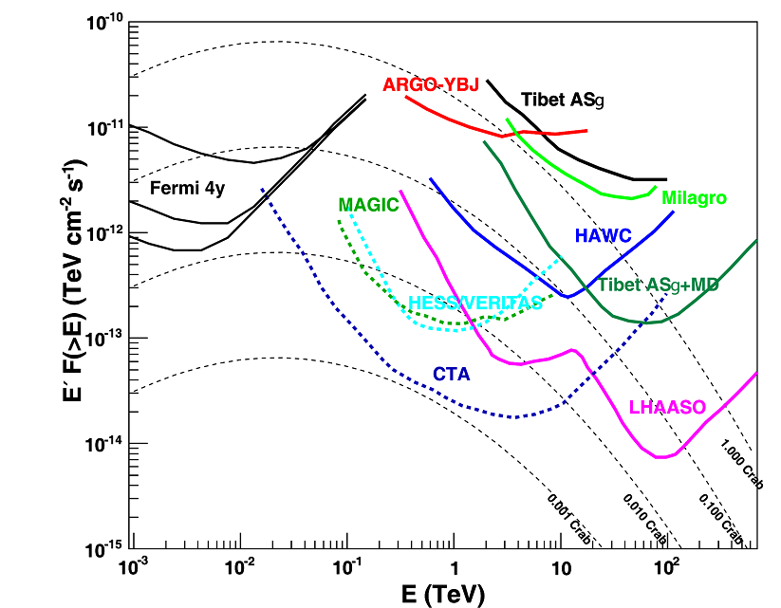
Status of VHE γ-ray
The low sensitivity at sub-100 GeV is the weakness of the current γ-ray detecting techniques.
To detect very high energy emission of sporadic γ-ray sources by future ground-based γ-ray experiment, larger FoV and lower energy threshold are the two most important goals to achieve.
S.Z. Chen, SCIENTIA SINICA Physica, Mechanica & Astronomica, 45,119503, 2015
Sensitivities of VHE gamma ray detectors. The three curves of Fermi indicate the sensitivity of 4 years observation for different positions (l=0◦, b=0◦), (l=0◦, b=30◦), (l=0◦, b=90◦) . The performance for HESS, MAGIC, VERITAS, CTA is based on 50 hours of data taking; for Tibet ASγ (ASγ+MD presented here is for final layout that include 12 MDs and a full filled array), Milagro, ARGO-YBJ, HAWC, LHAASO, it is based on one year of data.
Notes:
图 19 (网络版彩图) 各实验灵敏度, 其中 Fermi 从上至下三
条线分别代表 (l=0◦, b=0◦), (l=0◦, b=30◦), (l=0◦, b=90◦) 位
置处 4 年观测时间,为50 h观测时间(MAGIC为最新的双镜联合观测);
Tibet ASγ(ASγ+MD为12个MD水池和地面阵列全加密
结果), Milagro[34], ARGO-YBJ[32],, HAWC[34], LHAASO[35]
为一年观测时间

Slide 7
Wide FoV Cherenkov Telescope
Refractive Optics
Luisa Arruda, Report of PASC Winter School, Sesimbra, 12/2008
Camera
Traditional
New
Mirror
(Reflective)
Lens
(Refractive)
Camera
Novel technique using lenses: a lens can work as an efficient light collector!
large FoV;
large effective area;
good transmittance;
no shadows.

Slide 8
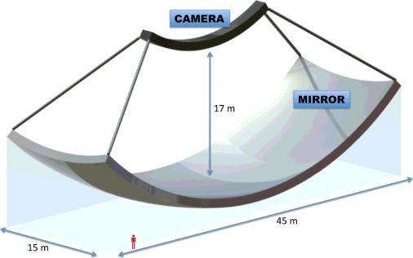
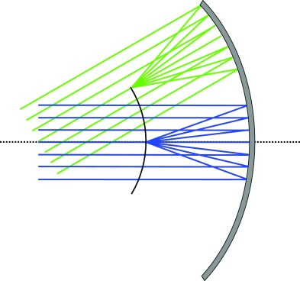
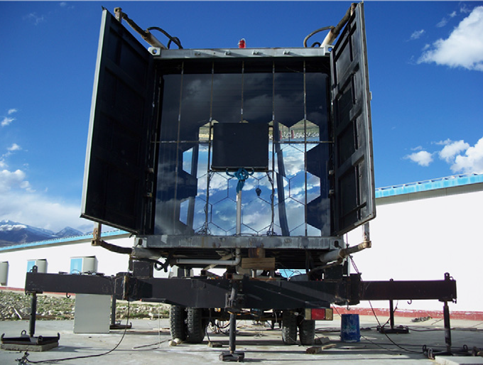
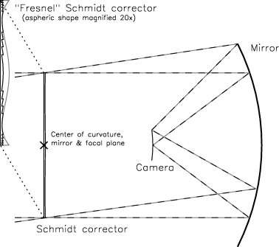
Wide FoV Cherenkov Telescope
Reflective Optics
WFCTA/CRTNT
Meridian Atmospheric CHErenkov TElescope (MACHETE)
S. S. Zhang, et.al , NIMA 629 (2011) 57–65
S. S. Zhang KIAA-WAP II Session 5: Gamma-ray II
J. Cortina et.al., APP 72 (2016) 46–54
  A 5m² spherical mirror
  FOV of 14º×16º with 0.5º pixels;
  to measure the energy spectrum and the composition of cosmic rays (CR) in the energy range from 30 TeV to several EeV.
Each of the two telescopes would have a camera with a FOV of 5×60 sq deg oriented along the meridian. About half of the sky drifts through this FOV in a year.
A spherical shape of 34 m radius .
Optical PSF of 0.06°for an ideal mirror.
15,000 photodetectors.
Mirror: 45m×14m=620m²
Camera: 1.5m×18m=27m²
Schmidt-type IACT
R. Mirzoyan et.al APP 31 (2009) 1–5
Notes:
Although there is some wide field view Cherenkov telescope array, such as WFCTA, the aim is to measure the energy spectrum and the composition of cosmic rays (CRs),not to devoted to gamma ray astronomy .The detail of WFCTA will see Zhang Shoushang’s talk tomorrow

Slide 9
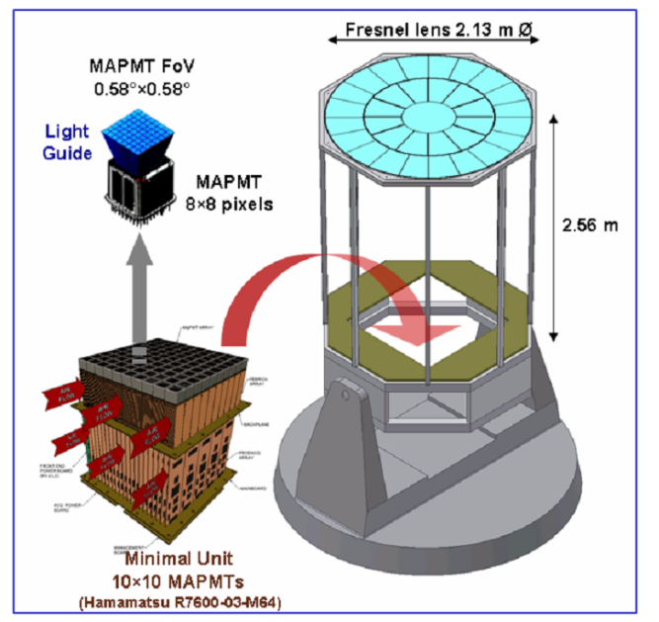
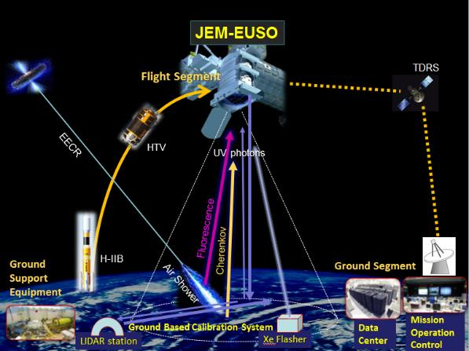
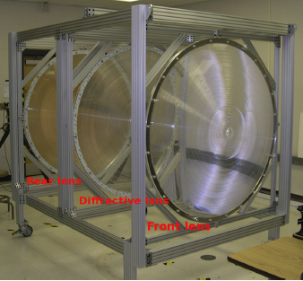
GAW: Gamma Air Watch
Wide FoV Cherenkov Telescope
Refractive Optics
JEM-EUSO is a Fresnel-optics refractive telescope devoted to
the observation of Ultra High Energy Cosmic Rays (UHECR).
Casolino M et al., (JEM-EUSO Collaboration) 2014 Exp. Atron.
The optics of GAW, composed by a large dimensional single-sided Fresnel lens, will allow to achieve large field of view.
Lens diameter 2650mm
Field of View(FoV) ±30º
The prototype lens also used by FAST have detected some candidates UHECRs in time coincidence with the TA FD.
G. Cusumano ICRC2011:ID1352
T. Fujii, et.al APP 74 (2016) 64–72
1.5m diameter three lens optics
Large dimensional Fresnel lens is very expensive.

Slide 10
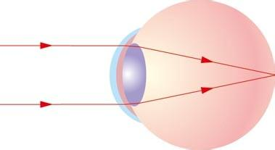
Conceptual design for the water-lens telescope array
Our concept is inspired by the structure of human eye.
High transmittance of purified water for ultraviolet photons
A refractive water-lens telescope with acrylic shell as a light collector for observing Cherenkov light induced by CRs and high energy γ-ray, especially aiming for detecting the high energy emission of sporadic γ-ray sources.
Effective
aperture
Glass shell
n=1.49
Human eye
Purified
waters
n=1.33
Vitreous humor
n=1.34
Aperture
Lens
n=1.41
Light concentrator
0° 20°
The focal plane and camera
Large dimensional water-lens is relatively cheap.

Slide 11
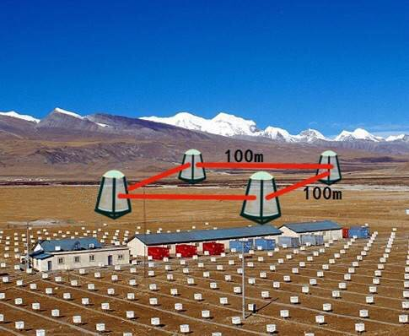
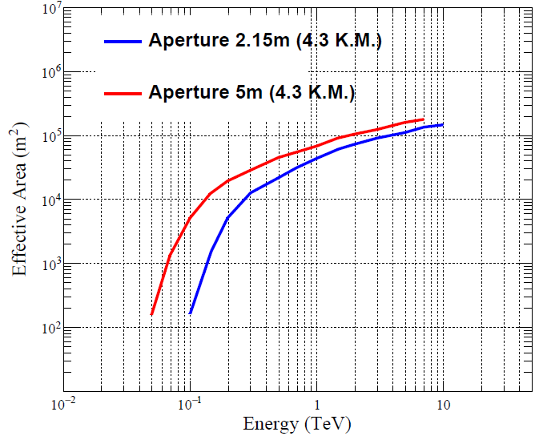
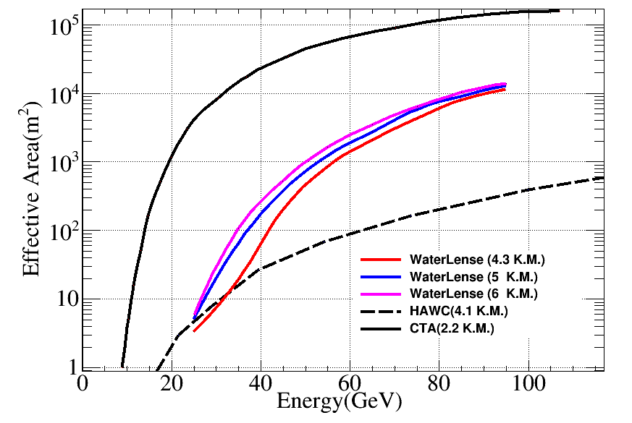
Preliminary simulation result: Effective Area
Aperture：6.9m
Effective aperture:5m
Focal length： 12m
Point spread function (PSF) r₈₀: 80mm (0.38º)
Field of View： 40º×40º
Array: 4 Telescopes
 | CTA(LSTs) | Water-lens telescope
Dimension | 24m | 5m（effective aperture）
Telescope number | 4 | 4
Effective area(m²)@60GeV | ~10⁴m² | ~10³m²
Field of View | tens of square degrees | thousand of square degrees

Slide 12
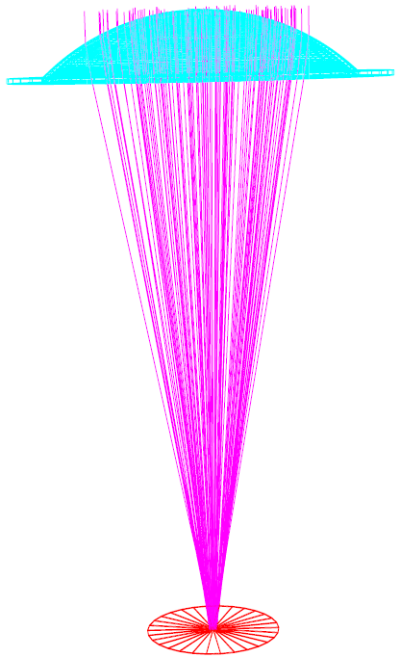
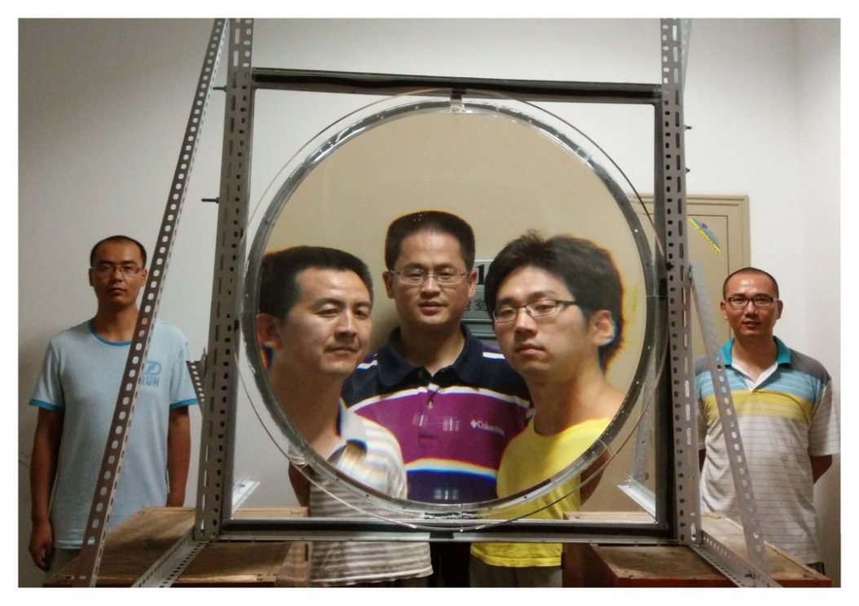
Water-lens prototype
Ø=0.9m
As a pathfinder, we designed and manufactured a water lens prototype with a thin spherical cap. We have successfully observed Cherenkov light induced by high energy CRs in coincidence with a scintillator EAS array in Yangbajing Observatory.

Slide 13
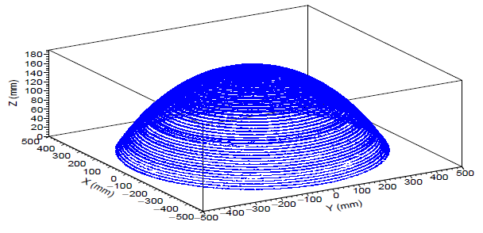
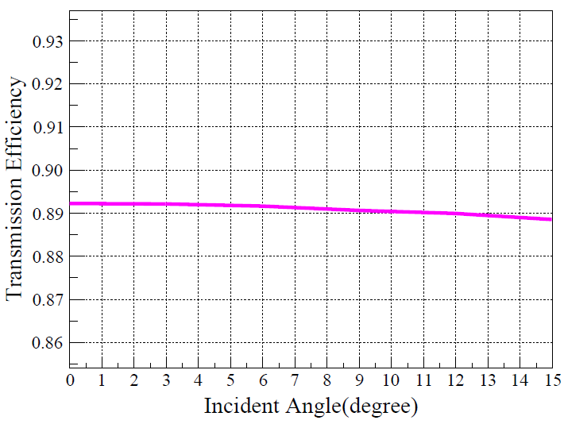
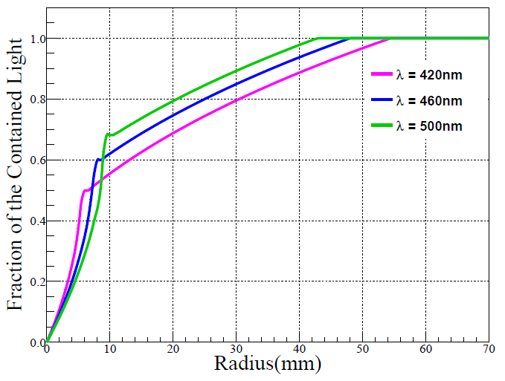
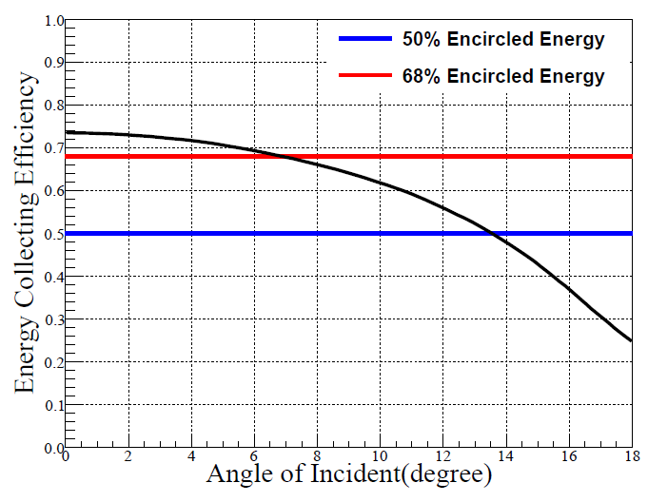
The optical property of water-lens prototype
λ=420nm
The surface accuracy of lens is ±1mm which has been assessed by industrial Computerized Tomography (CT).
Between the incident angle of 0º and 15º, the transmittance is approximately uniform around 89%.
r₈₀≤30mm
For the focal length of 168 cm, r₈₀ =30mm corresponds to ~1º, i.e, the focal plate scale of 2.9 cm deg-1.
The FOV of 14º×14º and 27º×27º will have 68% and 50% encircled energy respectively

Slide 14
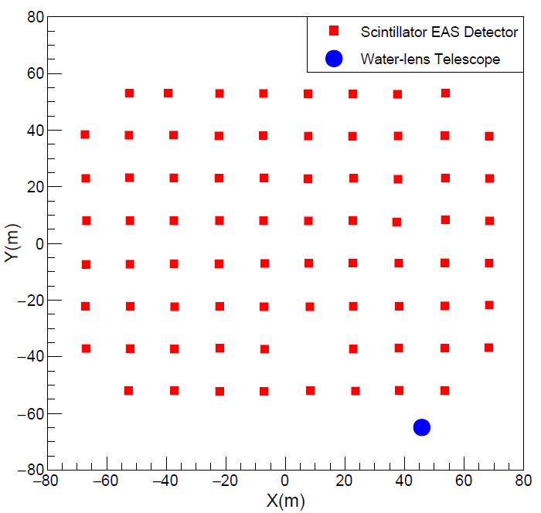
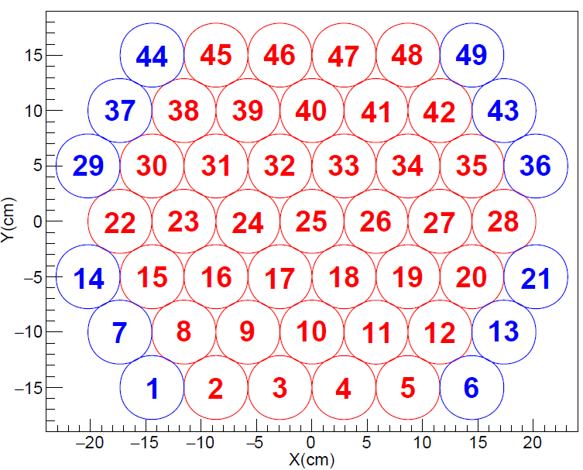
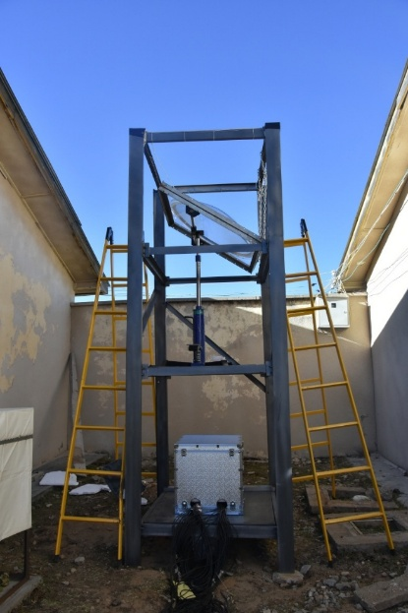
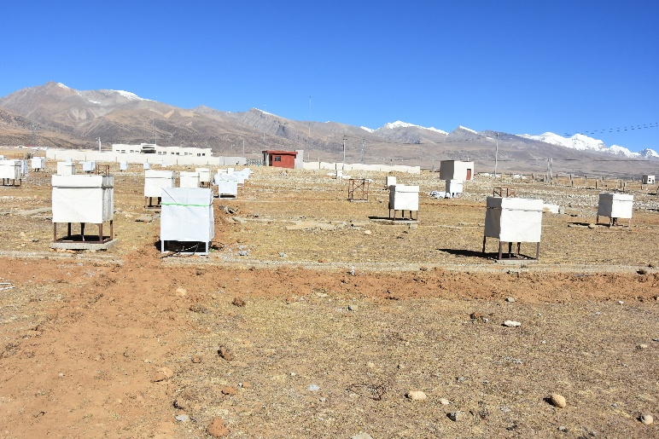
Off-line coincidence with the scintillator EAS array
Experiment conducted at Yangbajing Observatory in November 2016
R7725 PMT: 51mm (1.74º)
center hexagonal (37pixels) +outer guard ring (12 pixels)
The full aperture of the camera is 15º ×13º.
Camera
Layout of the coincidence expeiment
scintillator detector array
Water-lens

Slide 15
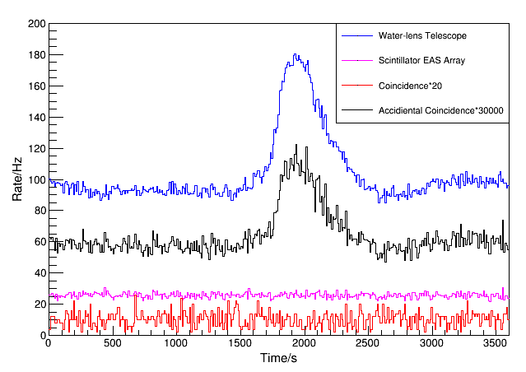
First observation of CRs
Water-lens
  Events:1.79×10⁷
  N₁=157.7Hz.
EAS array:
  Events:2.95×10⁶
  N₂=26.04Hz
Coincident event
  Coincident time window 400ns.
  Events:5.18×10⁴
  N=0.46Hz.
Accidental coincident rate
  R=2N₁N₂τ=0.003Hz.
Therefore the accidental coincident rate can be ignored, which indicates that the coincident events are real Cherenkov light induced by CRs.

Slide 16
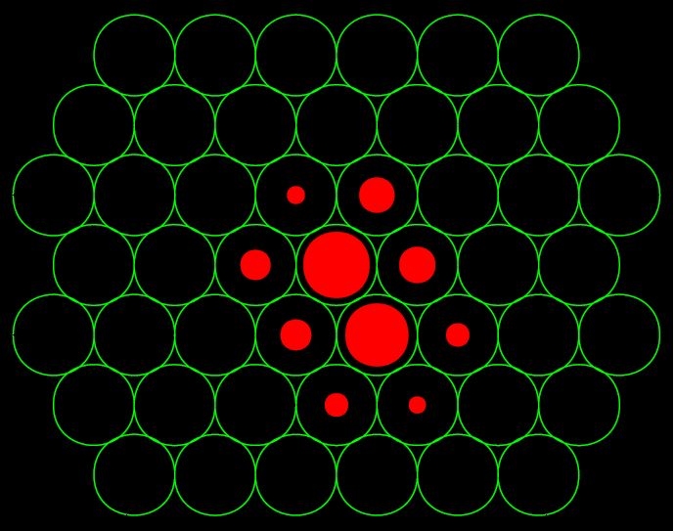
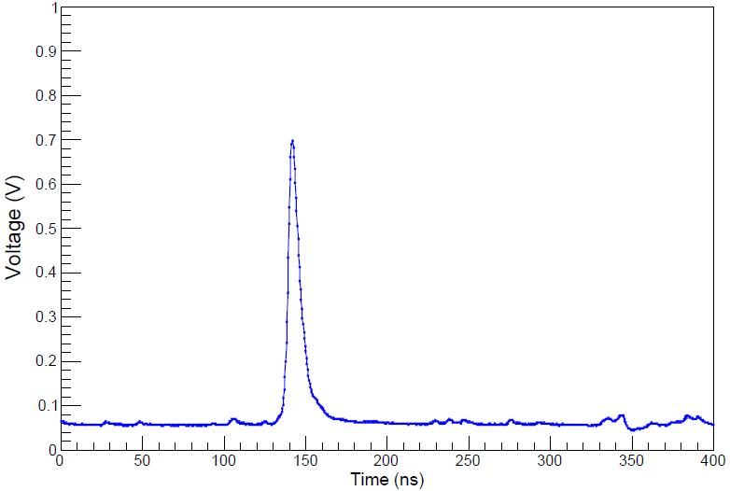
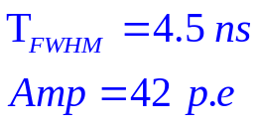
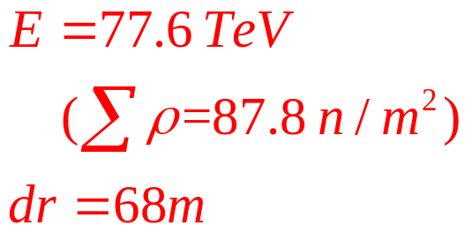
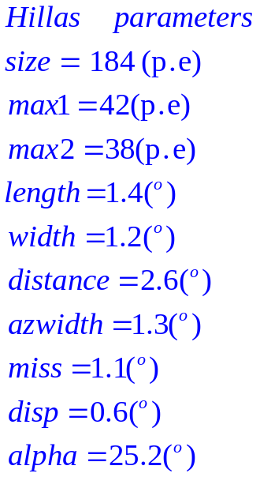
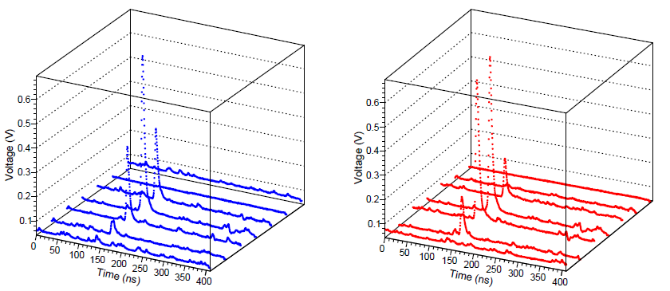
Typical CRs events
EAS Array
The intersection angle between the reconstructed direction of the EAS array and the water-lens is 0.5º.

Slide 17
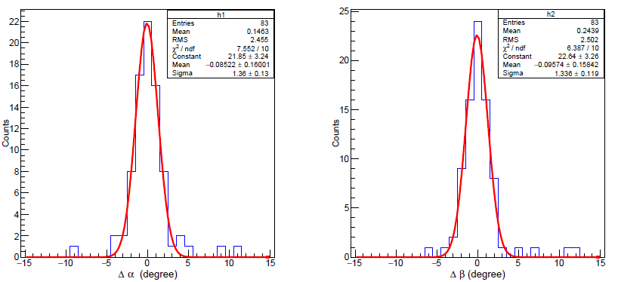
Estimation of angular distribution
∆α (Sigma) =1.36±0.13º
∆β (Sigma) =1.34±0.12º
Coincident events :
∆α, ∆β denote the E-W and N-S differences between the reconstructed direction cosine of the EAS array and one of water-lens.
No 21 PMT
The angular resolution of the EAS array can be estimated from Monte Carlo simulation, which is ~0.9º .
In this case, the angular distribution of the water-lens telescope is estimated as ~0.9º, which is consistent with the expectation.

Slide 18
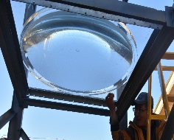
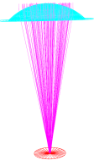
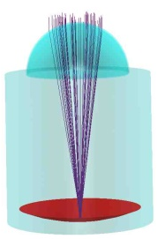
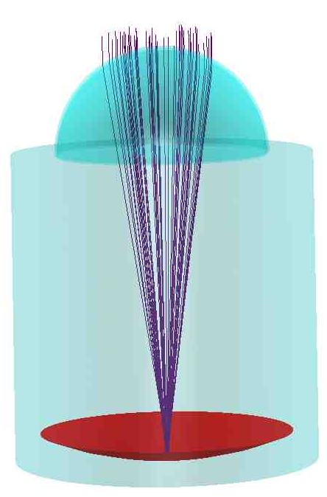
Statues and Future Plans
Step1
0.9m lens + EAS Array
CRs (done)
Step2
2m lens (being manufactured)
Step3
5m（Effective aperture） (2×2) lens
VHE emission of sporadic γ ray sources (e.g, GRBs)
Crab

Slide 19
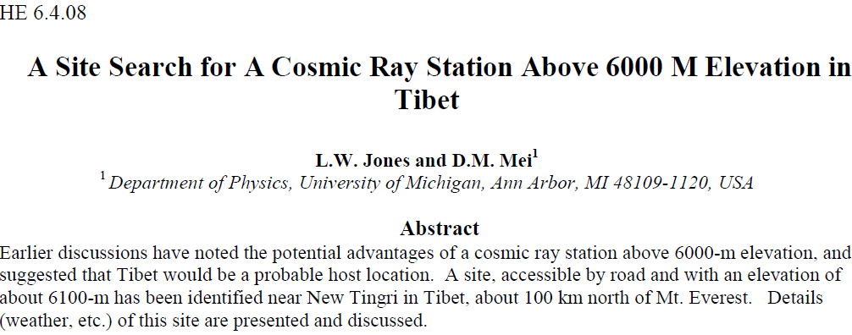
High altitude (>5000m) candidate site in Tibetan Plateau
Higher altitude can lower the energy threshold and enhance the effective area.
L. W. Jones and D.M. Mei, ICRC1999, 2.524.
Notes:
Next step we plan enlarge the dimension of water lens. Besides, we also could put the water-lens array at higher altitude to achieve lower energy threshold.
In fact, as early as 1999, Prof Jones proposed to built cosmic ray station above 6000-m elevation.
This is the ICRC article of Prof. Jones.

Slide 20
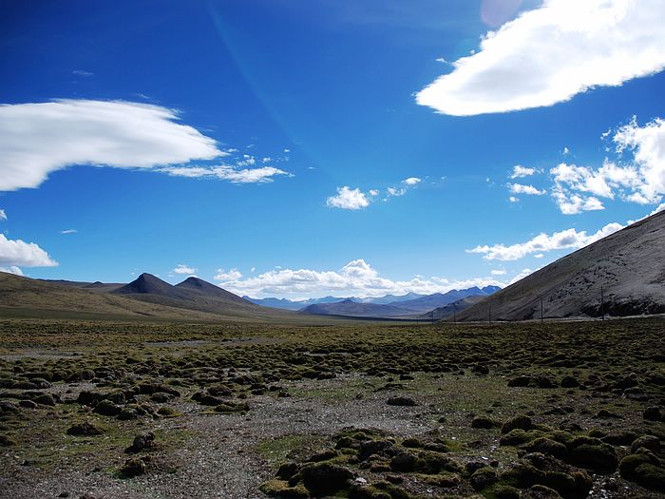
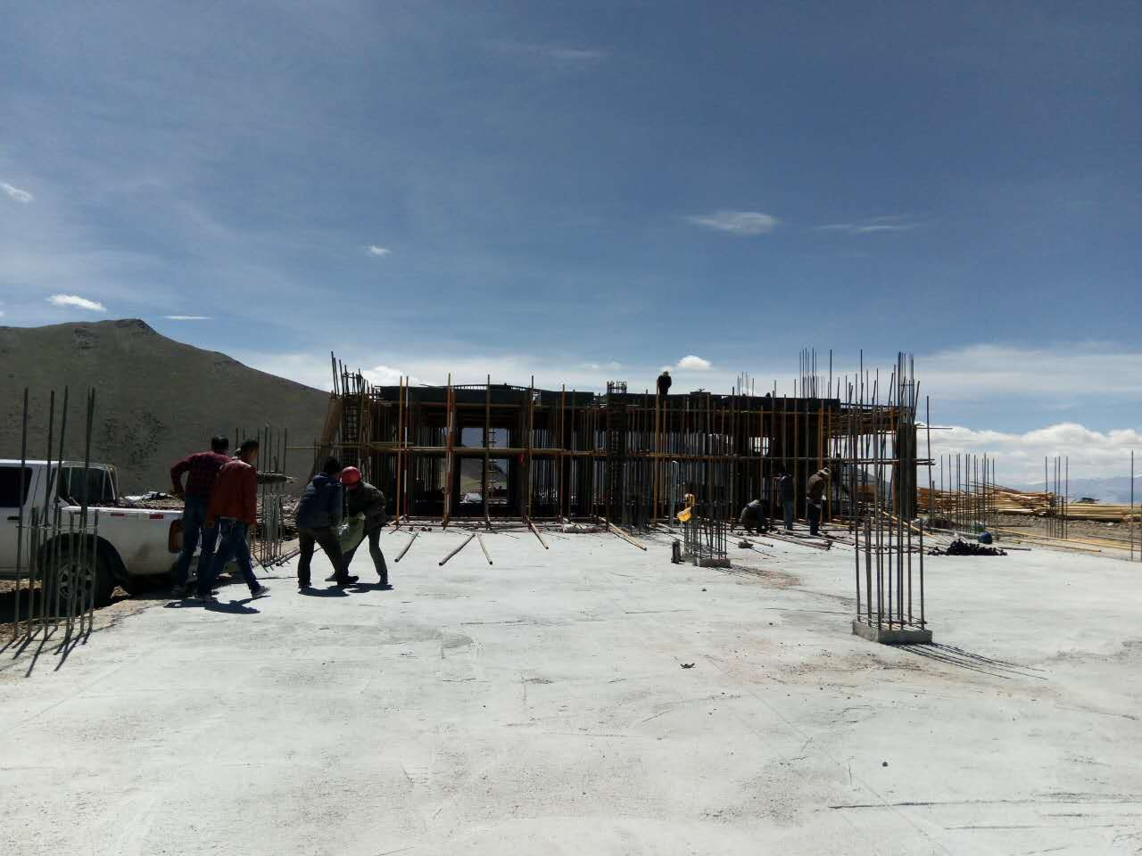
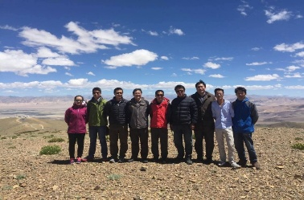
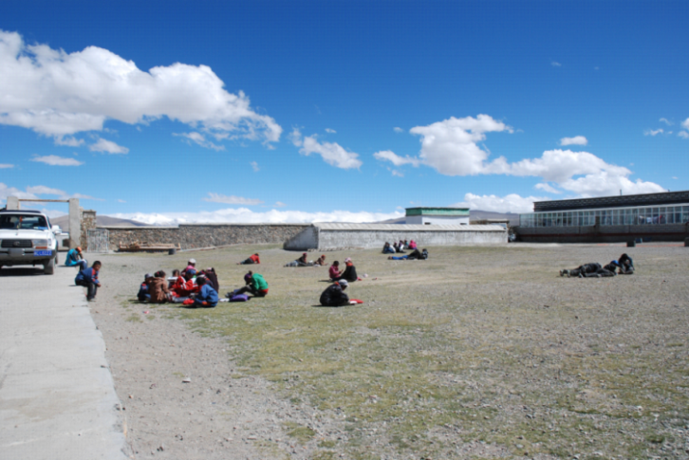
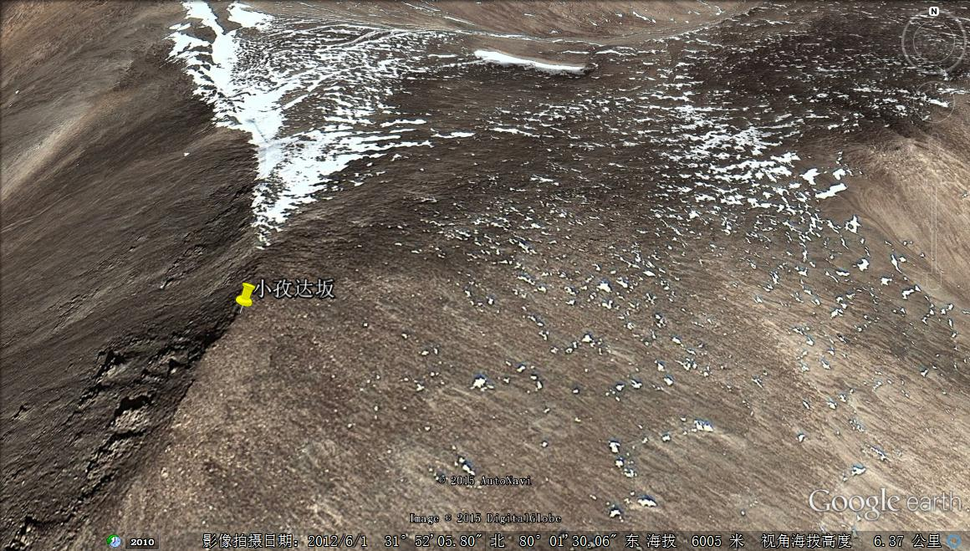
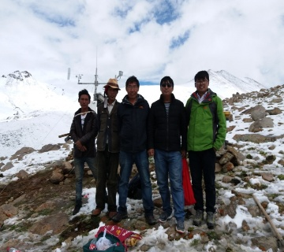
High altitude (>5000m) candidate site in Tibetan Plateau
Kangnila Pass:5200m
Ali-CPT I site： 5260m
2017.08
2016.07
Pumajiangtang elementary school:5030m
Xiaozidaban, Ali, 6000m
5300m
2017.07
Notes:
We also investigated some candidate sites in Tibetan plateau.
Locating at an altitude above 5000M altitude and accessible by high class road, the PuMaJiangTang has been identified as a suitable site for EAS experiment. There are tens of kilometers large area flat land, convenient traffic (215KM to LHASA), sufficient power (Tibet Middle Part Power Grid is covering this area), convenient communication (The base stations of China Mobile and China Telecom are in service, mobile can be sued)
phone can be used normally.), suitable for survival (~1000 local residents).
This candidate site reported by a CMB observation group.

Slide 21
Discussion and conclusion
  IACT that based on refractive optics may provide a innovative way for the ground-based γ ray astronomy by achieving a very large FoV.
The prototype telescope has successfully observed Cherenkov light that has induced by CRs .
The prototype telescope can achieve a 15º×13º FoV and a ~0.9º angular distribution which is suitable for taking certain Cherenkov images for air showers.
A larger dimensional water-lens with wide FoV at high altitude site would be used to lower the energy threshold for γ ray astronomy, especially for detecting VHE emission of GRBs, AGNs, and possible VHE electromagnetic counterparts of Gravitational Waves.

Slide 22
The end
Thank you!

Slide 23
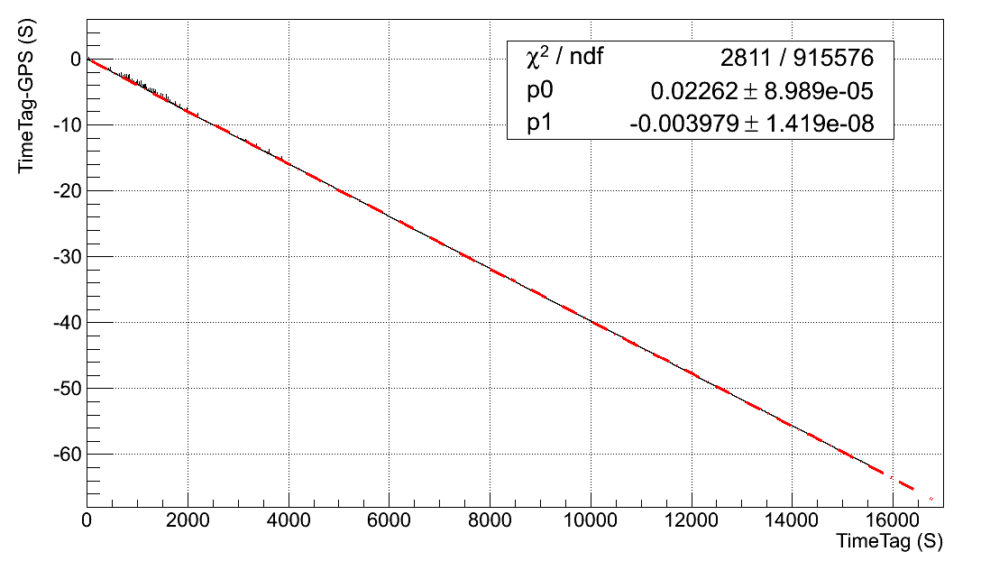
Coincidence with EAS array (Matching with Time Clock)
  FADC give every trigger signal a Trigger Time Tag, it records the Trigger arrival time; Resolution is ~17ns (8.5ns/bin*2bin=17ns).
  The trigger signal of water lens also send to EAS array through ED electronics.
  The ED electronics give trigger signal a GPS time ( Resolution is ~1ns)
  Water lens telescope and EAS array operated independently.
  We matching the data through GPS time and Trigger Time Tag.

Slide 24


The Focal Length (FL) and light spot
  f_{exp}=168±1.5 cm, and it is basically agreed with simulation result (f_{sim}=164 cm) using ZEMAX.
3.2cm
Image of HID (Xenon)
Floodlights
Image of car headlight
Notes:
We measured the focal length at outdoor, the distance between the light source and the lens was about 400 meters, it is very far and we can regard the light as approximate parallel light, so we obtain focal lens f_{exp}=168±1.5 cm, and it is basically agreed with simulation result (f_{sim}=164 cm) using ZEMAX.
The first figure shows a photo with coordinate paper of the optimal image of HID (Xenon) Floodlights
the focus spot is Dexpspot=32 mm, and it is consistent to simulation
results Dsimspot=30 mm (see Figure 3(b)) by using the real FL fexp=168 cm in simulation.
The second Figure shows a photo of the optimal image of car headlight (distance between two lamps
is 1.5 m, we can see obvious superposition of two image.

Slide 25



r₈₀ equals to 80mm, which corresponds to 0.38 degree for the focal length f=12m.
~10000 PMT 40º×40º

Slide 26




Slide 27



Slide 28


The influence of muon event on observation
  Coincidence measurement method
  When scintillator tiggers (trigger rates:~280Hz ), records 9 PMT signals
  Test1:PMTs with shade cover
  Test2:PMTs without shade cover
  Test results:
    Test 1: coincidence rate ~0.71 Hz;
    Test 2: coincidence rate ~0.63 Hz (muon hits on PMT directly);
  Discussion: To this prototype, muon event have little influence on observation.

